Slide 1
Sampling
Lecture 32

Slide 2
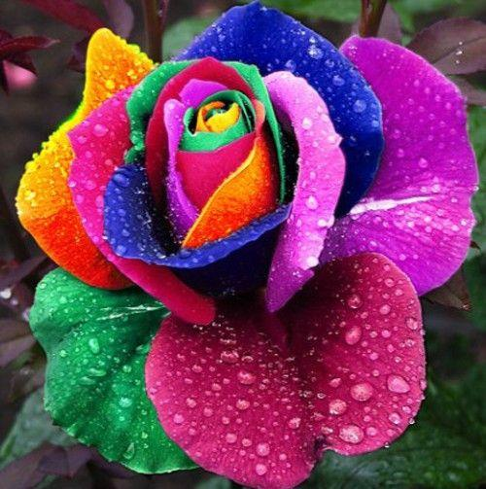
Effect of Interpolation

Slide 3
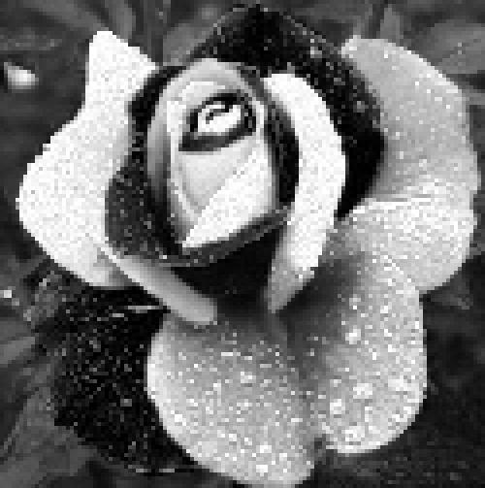


Effect of Interpolation

Slide 4
Effect of Interpolation
ZOH Linear Anti-aliased

Slide 5
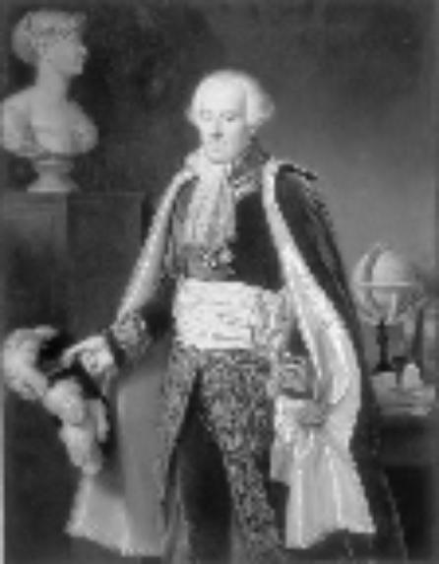
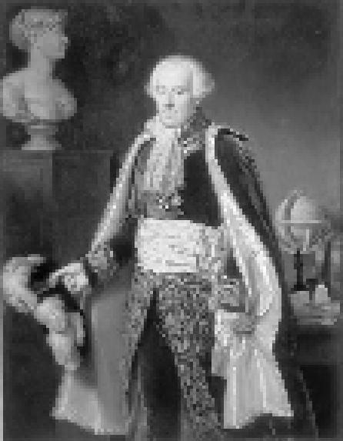
Linear ZOH

Slide 6

Anti-aliased Linear

Slide 7
Music
Music (linear interpolation)
Music (ZOH)

Slide 8

Music
Music (linear interpolation)
Music (ZOH)

Slide 9
Music
Music (linear interpolation)
Music (ZOH)

Slide 10
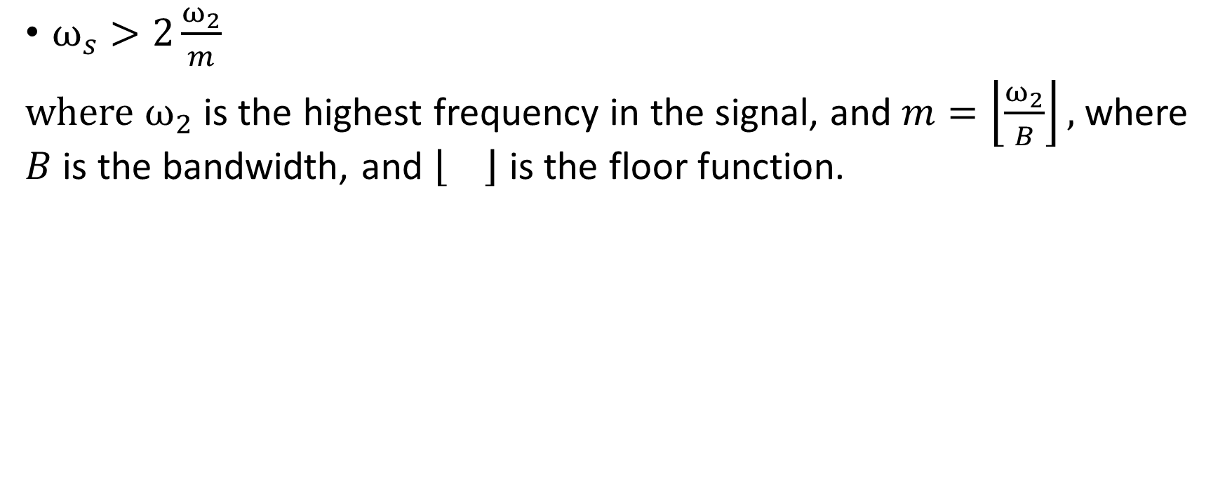
Passband Sampling
$ω_{s}>2\frac{ω_{2}}{m}$
where $ω_{2}$ is the highest frequency in the signal, and $m=\left\lfloor \frac{ω_{2}}{B}\right\rfloor ,$ where $B$ is the bandwidth, and is the floor function.

Slide 11
Laplace Transforms

Slide 12
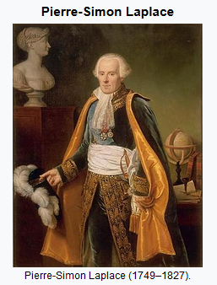
Pierre-Simon Laplace (1749-1827)
1. He was an astronomer
2. He has significant contributions in calculus, Bayesian estimations, black holes, Laplace equation and Laplace transforms .
3. Central limit theorem and absurd theories like rule of succession
4. He is known as the “Newton of France.”
5. D’Alembert interaction.

Slide 13
Continuous-Time Fourier Transform
Representing signals as linear combination of basic signals
Synthesis equation
Analysis equation

Slide 14
LTI systems
Impulse response h(t)
LTI

Slide 15
LTI systems
Impulse response h(t)
LTI

Slide 16
LTI systems
Impulse response h(t)
LTI

Slide 17
LTI systems
Impulse response h(t)
LTI

Slide 18
LTI systems
Impulse response h(t)
LTI

Slide 19
LTI systems
Impulse response h(t)
LTI

Slide 20
Laplace Transform
Bilateral
L

Slide 21
Connection between Laplace and Fourier Transform
New notation

Slide 22
Connection between Laplace and Fourier Transform
L may converge when F does not

Slide 23
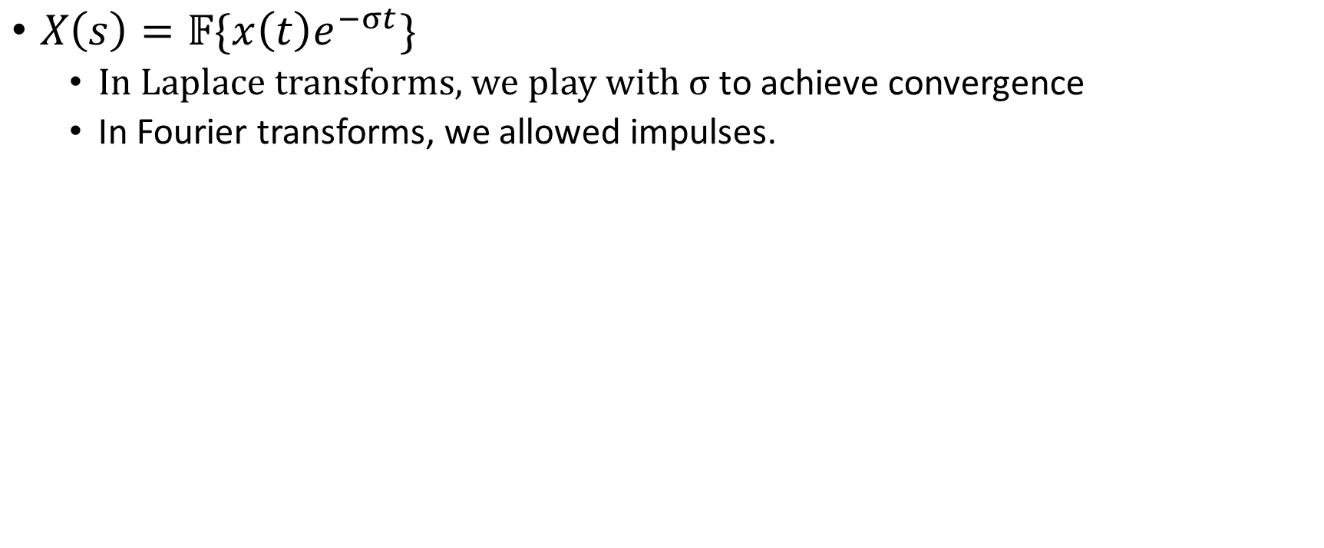
Difference between Laplace and Fourier Transform
$X\left(s\right)=𝔽\{x\left(t\right)e^{−σt}\}$
  In Laplace transforms, we play with $σ$ to achieve convergence
  In Fourier transforms, we allowed impulses.

